Slide 1
组会汇报
2018年11月6日

Slide 2
计算机网络
序号 | 会议简称 | 会议全称 | 出版社 | 网址
1 | ANCS | Architectures for Networking and Communications Systems | ACM/IEE E | http://dblp.uni-trier.de/db/conf/ancs/
2 | FORTE | Formal Techniques for Networked and Distributed Systems | Springer | http://dblp.uni-trier.de/db/conf/forte/
3 | LCN | IEEE Conference on Local Computer Networks | IEEE | http://dblp.uni-trier.de/db/conf/lcn/
4 | Globecom | IEEE Global Communications Conference, incorporating the Global Internet Symposium | IEEE | http://dblp.uni-trier.de/db/conf/globecom/
5 | ICC | IEEE International Conference on Communications | IEEE | http://dblp.uni-trier.de/db/conf/icc/
6 | ICCCN | IEEE International Conference on Computer Communications and Networks | IEEE | http://dblp.uni-trier.de/db/conf/icccn/
7 | MASS | IEEE International Conference on Mobile Ad hoc and Sensor Systems | IEEE | http://dblp.uni-trier.de/db/conf/mass/index.html
8 | P2P | IEEE International Conference on P2P Computing | IEEE | http://dblp.uni-trier.de/db/conf/p2p/
9 | IPCCC | IEEE International Performance Computing and Communications Conference | IEEE | http://dblp.uni-trier.de/db/conf/ipccc/

Slide 3
计算机网络
10 | WoWMoM | IEEE International Symposium on a World of Wireless Mobile and Multimedia Networks | IEEE | http://dblp.uni-trier.de/db/conf/wowmom/
11 | ISCC | IEEE Symposium on Computers and Communications | IEEE | http://dblp.uni-trier.de/db/conf/iscc/
12 | WCNC | IEEE Wireless Communications & Networking Conference | IEEE | http://dblp.uni-trier.de/db/conf/wcnc/
13 | Networking | IFIP International Conferences on Networking | IFIP | http://dblp.uni-trier.de/db/conf/networking/index. html
14 | IM | IFIP/IEEE International Symposium on Integrated Network Management | IFIP/IEEE | http://dblp.uni-trier.de/db/conf/im/index.html
15 | MSWiM | International Conference on Modeling, Analysis and Simulation of Wireless and Mobile Systems | ACM | http://dblp.uni-trier.de/db/conf/mswim/
16 | NOMS | Asia-Pacific Network Operations and Management Symposium | IFIP/IEEE | http://dblp.uni-trier.de/db/conf/apnoms/
17 | HotNets | The Workshop on Hot Topics in Networks | ACM | http://dblp.uni-trier.de/db/conf/hotnets/
18 | WASA | International Conference on Wireless Algorithms, Systems, and Applications | Springer | http://dblp.uni-trier.de/db/conf/wasa/

Slide 4
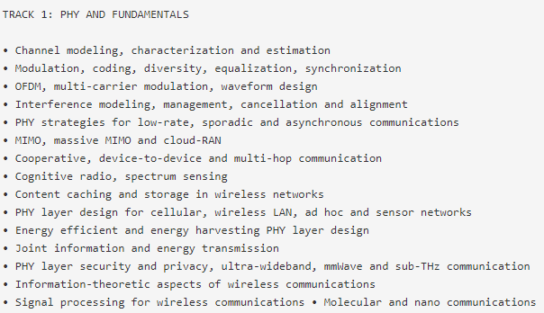
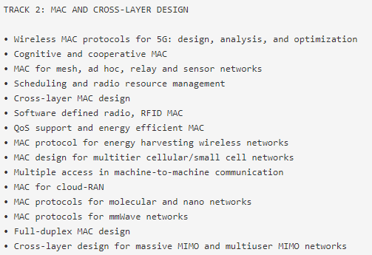
WCNC

Slide 5
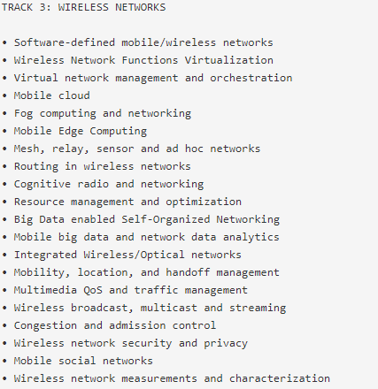
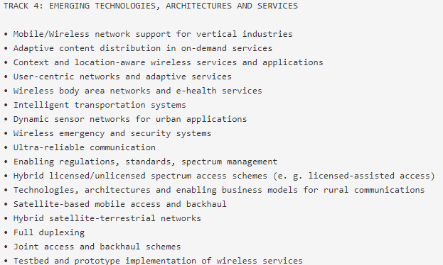
录取率：2016年48.4% 2015年45% 2012年44.1%
截稿日期：2018.9.25

Slide 6
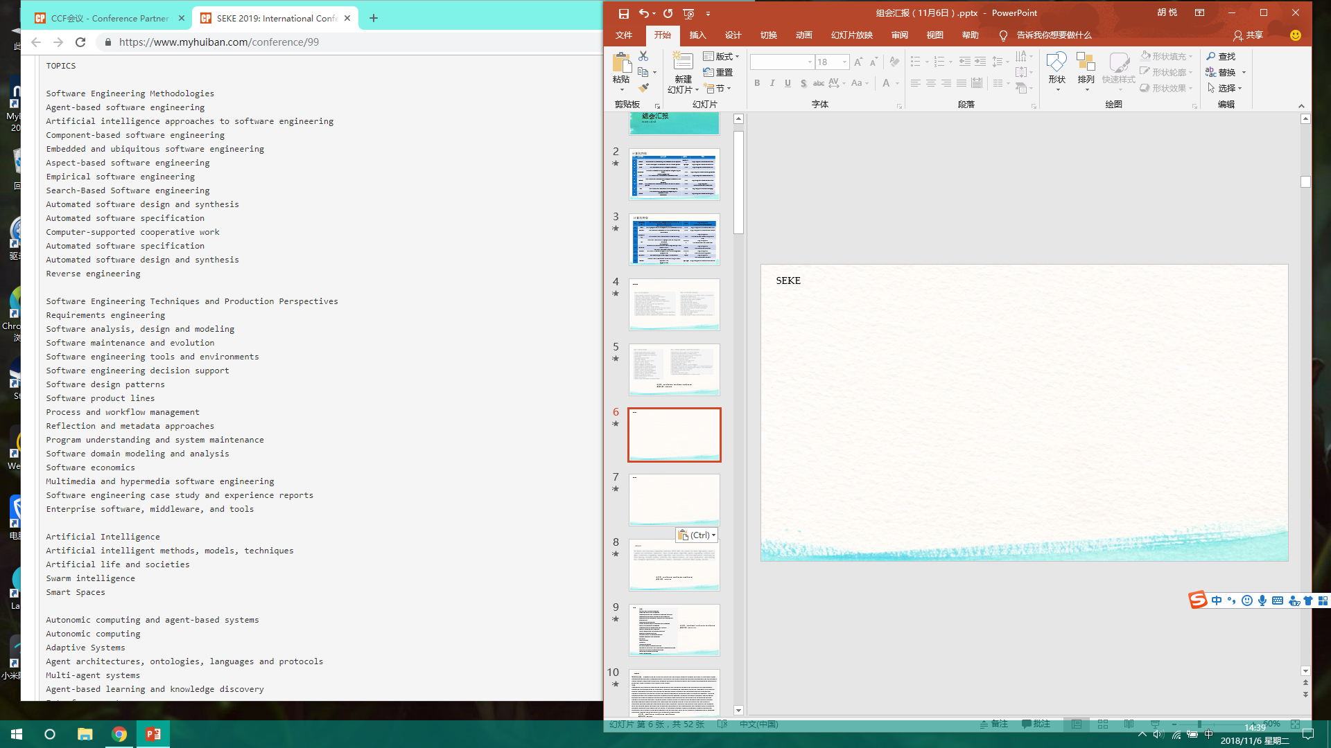
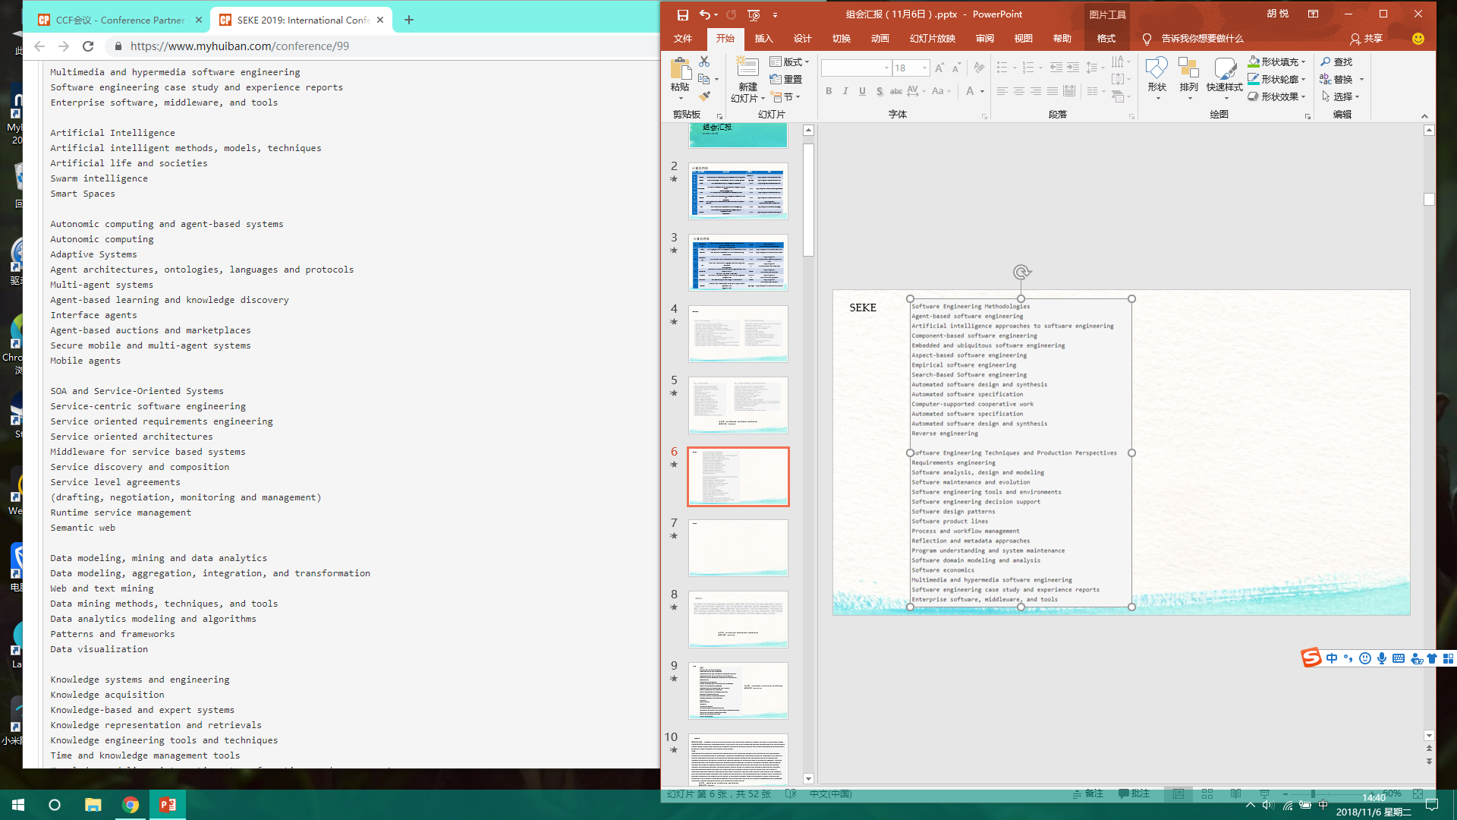
SEKE

Slide 7

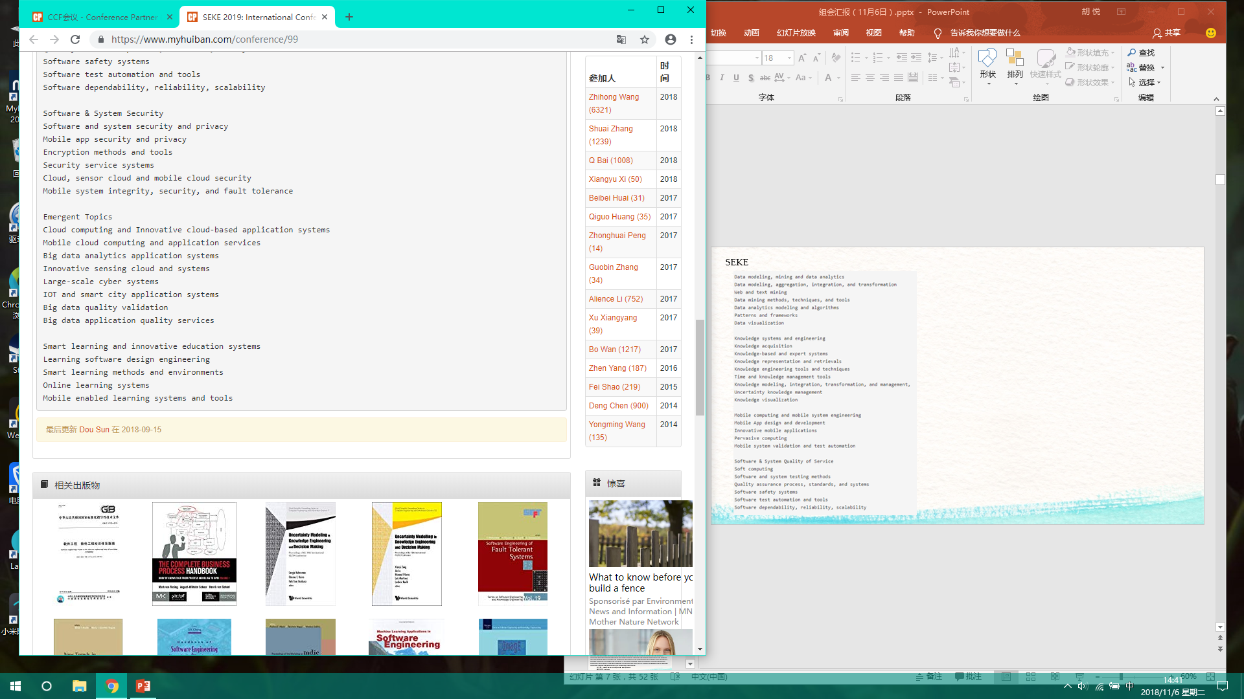
SEKE
录取率：2005年51.1% 2003年66.7%
截稿日期：2019.3.1

Slide 8

GECCO
录取率：2010年45.3% 2009年41.4% 2008年44.1%
截稿日期：2019.1.30

Slide 9
ICC
主题：
Ad Hoc and Sensor Networks
Cognitive Radio and Networks
Communication and Information Systems Security Communication QoS, Reliability and Modeling Communication Software, Services and Multimedia Applications
Communication Theory
Green Communication Systems and Networks
Mobile and Wireless Networks
Next-Generation Networking and Internet
Optical Networks and Systems
Signal Processing for Communications
Wireless Communications
Selected Areas in Communications
Access Systems and Networks
Big Data
Data Storage
E-Health
Internet of Things
Millimeter Wave Communications
Molecular, Biological, and Multi-Scale Communications Satellite and Space Communications
Smart Grid Communications
Social Networking
录取率：2018年40% 2017年38.1% 2016年38.9%
截稿日期：2018.11.14

Slide 10
FORTE
特别关注主题：Software quality, reliability, availability, and safety; Security, privacy, and trust in distributed and/or communicating systems; Service-oriented, ubiquitous, and cloud computing systems Component- and model-based design Object technology, modularity, software adaptation Self-stabilization and self-healing/organizing Verification, validation, formal analysis, and testing of the above. 主题：
Languages and semantic foundations New modeling and language concepts for distribution and concurrency; semantics for different types of languages, including programming languages, modeling languages, and domain-specific languages; real-time and probability aspects Formal methods and techniques Design, specification, analysis, verification, validation, testing and runtime verification of various types of distributed systems, including communications and network protocols, service-oriented systems, adaptive distributed systems, cyber-physical systems and sensor networks Foundations of security New principles for qualitative and quantitative security analysis of distributed systems, including formal models based on probabilistic concepts Applications of formal methods Applying formal methods and techniques for studying quality, reliability, availability, and safety of distributed systems Practical experience with formal methods Industrial applications, case studies and software tools for applying formal methods and description techniques to the development and analysis of real distributed systems. Emerging challenges and hot topics in distributed systems (broadly construed) Formal specification, verification and analysis of emerging systems and applications, such as, for instance, software-defined networks, distributed ledgers, smart contracts, and blockchain technologies.
录取率：2009年39.1% 2008年45.5% 2007年32.8%
截稿日期：2019.2.1

Slide 11
ICWE
Web application modeling and engineering
Web mining and knowledge extraction
Web Big Data and Web data analytics
Mobile Web applications
Web of Things applications
Social Web applications
Web crowdsourcing and human computation
Semantic Web and Linked Open Data applications
Quality and accessibility aspects of Web applications
Web composition and mashups
Web user interfaces
Security and privacy
Web programming
Web services, computing, and standards
录取率：2005年38.3% 2004年32.8% 2003年51.6%
截稿日期：2019.1.18

Slide 12

ACISP
录取率：2014年35.2% 2013年35.9% 2012年39.3%
截稿日期：2019.2.15

Slide 13

COMPSAC
录取率：2006年31.1% 2005年24.9% 2004年30.7%
截稿日期：2019.1.21

Slide 14
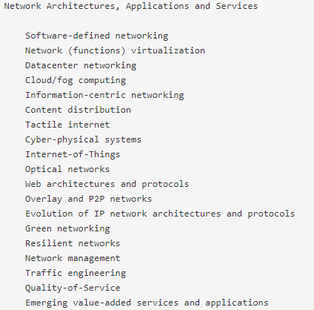
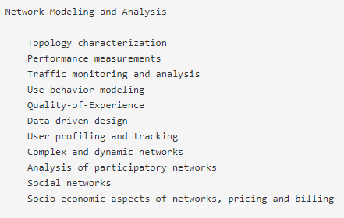
Networking

Slide 15
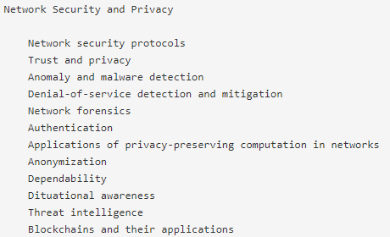
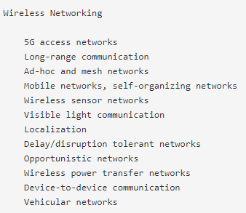
录取率：2018年28% 2017年28.7% 2016年28.5%
截稿日期：2018.1.2

Slide 16
LCN
主题：
• Personal and wearable networks • Wireless ad hoc & sensor networks
• Information-centric networking • Embedded networks
• Opportunistic networking • Delay-tolerant networks
• Cognitive radio networks • Vehicular networks
• Smart Grid communications • Underwater sensor networks
• Cyber-physical systems • Social networks
• Mobile and ubiquitous networking • Green networking
• Overlay and peer-to-peer networks • Local-area and metropolitan-area networks
• Storage-area networks • Routing and transport protocols
• Big Data Networking • Cloud computing and networking
• Software Defined Networking and Network Function Virtualization • Internet of Things
• Link technologies • Adaptive networking applications
• Authentication, authorization, accounting • Security and privacy
• Cross-layer optimization • Mobility and Location-dependent services
• Multimedia and real-time communication • Machine-to-machine communications for smart environments
• Smart Cities • Network traffic characterization and measurements
• Network management, reliability and QoS • Performance evaluation of networks
• Testbeds for network experiments • Network coding
• Optical and high-speed access networks • E-Health networking
录取率：2017年28.4% 2016年25.1% 2015年30.3%
截稿日期：2018.5.3

Slide 17
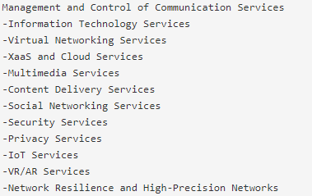
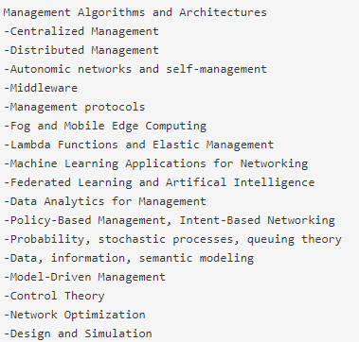
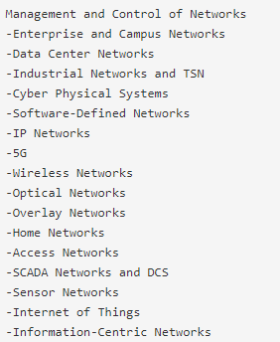
IM

Slide 18
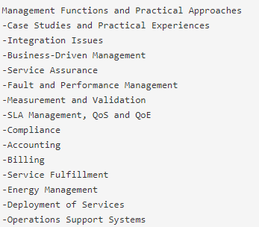
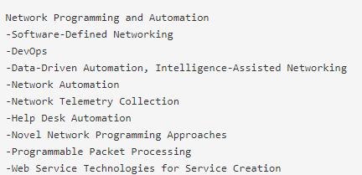
录取率：2017年28.6% 2015年27.2% 2013年27%
截稿日期：2018.8.19

Slide 19
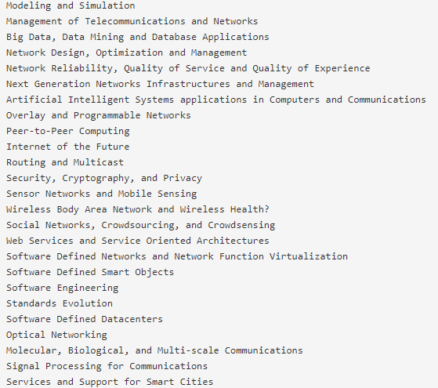
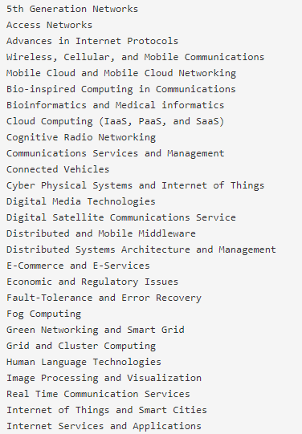
主题：
ISCC
录取率：2017年28.4% 2016年25.1% 2015年30.3%
截稿日期：2018.5.3

Slide 20
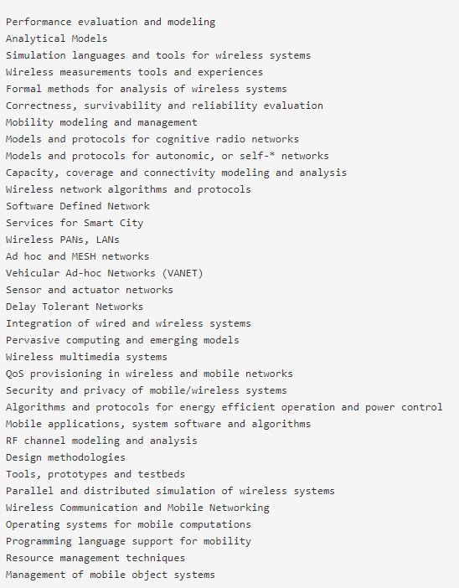
MSWiM
录取率：2018年27.4% 2014年21.9% 2013年26.3%
截稿日期：2018.5.10

Slide 21
IPCCC
主题：
• Big Data Processing and Analytics
• Cache, Memory, and Disk Storage Systems
• Cloud Computing • Crowdsourcing Systems
• Cyber Physical Systems • Data Centers
• Embedded Systems • Fundamental Theory and Algorithms
• Internet of Things • Internet Services and Network Management
• Mobile Ad Hoc, Sensor and Mesh Networks • Multimedia Networking
• Many-core and Heterogeneous Computing • Network Data Mining
• Network Information Assurance and Security • Network Protocols
• Online Social Network Analysis • Parallel and Distributed Systems
• Performance Evaluation and Modeling
• Security and Privacy
• Smart Grid and Intelligent Mission Critical Operations
• Smart Health Systems, Wearable, and Implantable Systems
• Smartphone and Mobile Applications
• Software Defined Networking
• Ubiquitous Computing
• Wireless Communication and Networks
• Workload Characterization and its Impacts on Architecture Design
录取率：2013年27.1%
2012年27.8%
2011年27.9%
截稿日期：2018.8.3

Slide 22
MASS
主题：
Algorithms for MANETs and WSNs、 Application Layer Protocols 、Clustering, topology control, coverage, and connectivity 、Cognitive networking 、Cooperative and cognitive communication 、Cooperative sensing, compressive sensing, sensing from communications 、Cloud, crowd-sourced, participatory and (mobile) social sensing 、Cyber-physical systems and applications、 Data gathering, fusion, and dissemination 、Energy-efficient architectures, algorithms, and protocols、 Experiences in real-world applications and deployments、 Heterogeneous networks、 Internet of Things (IoT) devices, gateways, and infrastructure 、Localization and Location Based Services、 Measurements, experimental systems and test-beds、 Mobile computing and networking 、Mobility modeling and management、 Multi-channel, multi-radio and MIMO technologies、 Network components, operating systems, and middleware 、Opportunistic networking, delay tolerant networking 、QoS and Resource management、 Robotic networks、 Routing protocols 、Scalability, stability, and robustness of networks and sensor systems、 Security and privacy at all layers, including the physical layer 、Sensor enabled drone, UAV, UUV systems 、Smart grid, healthcare, transportation applications、 Vehicular networks and protocols 、Wearable and human-centric devices and networks
录取率：2014年26.5% 2013年38.2% 2012年30.1%
截稿日期：2018.4.15

Slide 23
WoWMoM
主题：
Ad-hoc, sensor, mesh and vehicular wireless networks 、Content-centric architectures for wireless, mobile and multimedia networks 、Context-awareness in wireless, mobile and multimedia networks 、Cognitive communications and networking、 Dependability and survivability issues for wireless, mobile and multimedia networks 、Energy-efficiency for wireless, mobile and multimedia networks、 Internet/Web of Things 、Localisation, tracking, and mobility management and services、 Middleware services for wireless, mobile and multimedia networks 、Mobile applications and services over 5G networks、 Mobile big data networking and services 、Mobile cloud computing 、Mobile applications and services over 5G networks、 Mobile edge computing、 Mobile health networking、 Mobile network traffic characterization and measurements 、Mobile social networks、 Modelling, analysis, and performance evaluation 、Network virutalisation and software-defined wireless networks 、Opportunistic and delay-tolerant networks、 Participatory, mobile and urban sensing 、Resource management for QoS/QoE provisioning RFID, NFC, and Machine-to-machine (M2M) communications、 Satellite and space networking、 Seamless inter-networking and self-organisation 、Security, trust and privacy issues for wireless, mobile and multimedia networks、 System prototypes, measurements, real-world deployment, and experiences 、Underwater wireless, mobile and multimedia networks 、Virtual mobile infrastructure 、Wireless BAN, PAN, LAN, MAN and WAN 、Wireless multimedia systems, services and applications 、Wearable Computing 、PAPER SUBMISSION AND PUBLICATION
录取率：2016年26.8% 2015年19.8% 2014年20.2%
截稿日期：2018.12.18

Slide 24
ANCS
主题：
● Wired and wireless network architectures (e.g., data center networks, WAN, 5G)
● Networked-systems architectures
● SDN/NFV architectures and systems
● Converged architectures (network, compute, memory and storage)
● Hardware/software co-design for networking, including arising issues
● Reconfigurable and programmable architectures
● Network security techniques, architectures, and devices
● Network measurement techniques, tools, architectures, and devices
● Accelerators, offload engines and Single-chip networking elements
● Energy efficient designs
录取率：2016年24% 2012年28.1% 2009年23.3%
截稿日期：2018.4.2

Slide 25
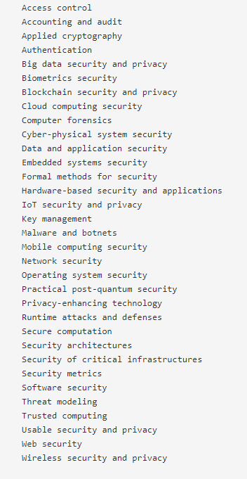
AsiaCCS
录取率：2016年19.1% 2015年17.8% 2014年19.6%
截稿日期：2019.1.15

Slide 26
P2P
主题：
- P2P systems and applications
P2P applications and systems running in the Internet, clouds and mobile systems
Leveraging users' cloud resources, including personal and enterprise clouds
Crowdsourcing
Security, privacy, anonymity, and anti-censorship
Economics of P2P and edge computing
Overlay architectures and technologies
Self-organization and self-management
Citizen participation systems
Decentralized alternatives to logically centralized services such as web search and social networks
Decentralized policy enforcement, participation incentives, trust, and reputation
User experience and engagement as the drivers for systems and network design
Blockchain architectures and decentralized cryptocurrencies
Experience with deployed systems and applications
Measurements and modeling of systems and networks
- Performance, availability, robustness, and scalability
录取率：2013年19.1% 2012年24% 2011年30.1%
截稿日期：2015.5.11

Slide 27
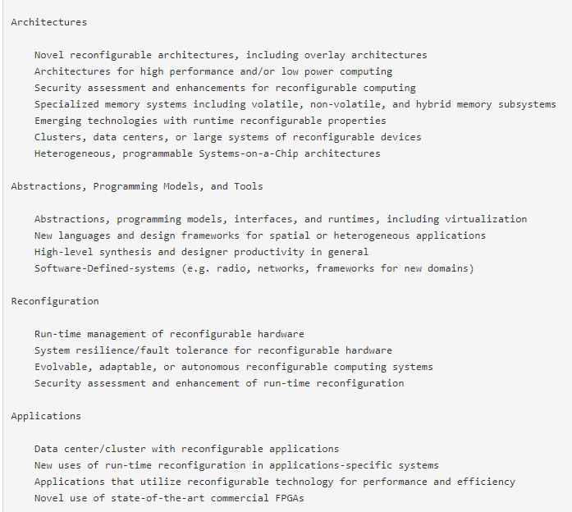
FCCM
截稿日期：2019.1.7

Slide 28
软件工程/系统软件/程序设计语言
1 | PASTE | ACMSIGPLAN-SIGSOFT Workshop on Program Analysis for Software Tools and Engineering | ACM | http://dblp.uni-trier.de/db/conf/paste/
2 | APLAS | Asian Symposium on Programming Languages and Systems | Springer | http://dblp.uni-trier.de/db/conf/aplas/
3 | APSEC | Asia-Pacific Software Engineering Conference | IEEE | http://dblp.uni-trier.de/db/conf/apsec/
4 | COMPSAC | International Computer Software and Applications Conference | IEEE | http://dblp.uni-trier.de/db/conf/compsac/
5 | ICECCS | IEEE International Conference on Engineering of Complex Computer Systems | IEEE | http://dblp.uni-trier.de/db/conf/iceccs/
6 | SCAM | IEEE International Working Conference on Source Code Analysis and Manipulation | IEEE | http://dblp.uni-trier.de/db/conf/scam/
7 | ICFEM | International Conference on Formal Engineering Methods | Springer | http://dblp.uni-trier.de/db/conf/icfem/
8 | TOOLS | International Conference on Objects, Models, Components, Patterns | Springer | http://dblp.uni-trier.de/db/conf/tools/index.html

Slide 29
9 | PEPM | ACM SIGPLAN Symposium on Partial Evaluation and Semantics Based Programming Manipulation | ACM | http://dblp.uni-trier.de/db/conf/pepm/
10 | QRS | The IEEE International Conference on Software Quality, Reliability and Security | IEEE | http://paris.utdallas.edu/qrs/
11 | SEKE | International Conference on Software Engineering and Knowledge Engineering | KSI | http://dblp.uni-trier.de/db/conf/seke/
12 | ICSR | International Conference on Software Reuse | Springer | http://dblp.uni-trier.de/db/conf/icsr/
13 | ICWE | International Conference on Web Engineering | Springer | http://dblp.uni-trier.de/db/conf/icwe/
14 | SPIN | International SPIN Workshop on Model Checking of Software | Springer | http://dblp.uni-trier.de/db/conf/spin/index.html
15 | LOPSTR | International Symposium on Logic-based Program Synthesis and Transformation | Springer | http://dblp.uni-trier.de/db/conf/lopstr/
16 | TASE | International Symposium on Theoretical Aspects of Software Engineering | IEEE | http://dblp.uni-trier.de/db/conf/tase/
17 | ICST | The IEEE International Conference on Software Testing, Verification and Validation | IEEE | http://dblp.uni-trier.de/db/conf/icst/
18 | ATVA | International Symposium on Automated Technology for Verification and Analysis | Springer | http://dblp.uni-trier.de/db/conf/atva/

Slide 30
19 | ISPASS | IEEE International Symposium on Performance Analysis of Systems and Software | IEEE | http://dblp.uni-trier.de/db/conf/ispass/
20 | SCC | International Conference on Service Computing | IEEE | http://dblp.uni-trier.de/db/conf/IEEEscc/
21 | ICSSP | International Conference on Software and System Process | ISPA | http://dblp.uni-trier.de/db/conf/ispw/
22 | MSR | Working Conference on Mining Software Repositories | IEEE/ACM | http://dblp.uni-trier.de/db/conf/msr/
23 | REFSQ | Requirements Engineering: Foundation for Software Quality | Springer | http://dblp.uni-trier.de/db/conf/refsq/
24 | WICSA | Working IEEE/IFIP Conference on Software Architecture | IEEE | http://dblp.uni-trier.de/db/conf/wicsa/
25 | EASE | Evaluation and Assessment in Software Engineering | ACM | http://dblp.uni-trier.de/db/conf/ease/

Slide 31
人工智能
1 | ACCV | Asian Conference on Computer Vision | Springer | http://dblp.uni-trier.de/db/conf/accv/
2 | CoNLL | Conference on Natural Language Learning | CoNLL | http://dblp.uni-trier.de/db/conf/conll
3 | GECCO | Genetic and Evolutionary Computation Conference | ACM | http://dblp.uni-trier.de/db/conf/gecco/
4 | ICTAI | IEEE International Conference on Tools with Artificial Intelligence | IEEE | http://dblp.uni-trier.de/db/conf/ictai/
5 | ALT | International Conference on Algorithmic Learning Theory | Springer | http://dblp.uni-trier.de/db/conf/alt/
6 | ICANN | International Conference on Artificial Neural Networks | Springer | http://dblp.uni-trier.de/db/conf/icann/
7 | FGR | International Conference on Automatic Face and Gesture Recognition | IEEE | http://dblp.uni-trier.de/db/conf/fgr/
8 | ICDAR | International Conference on Document Analysis and Recognition | IEEE | http://dblp.uni-trier.de/db/conf/icdar/
9 | ILP | International Conference on Inductive Logic Programming | Springer | http://dblp.uni-trier.de/db/conf/ilp/
10 | KSEM | International conference on Knowledge Science,Engineering and Management | Springer | http://dblp.uni-trier.de/db/conf/ksem/

Slide 32
 |  | Recognition
13 | ICB | International Joint Conference on Biometrics | IEEE | http://dblp.uni-trier.de/db/conf/icb/
14 | IJCNN | International Joint Conference on Neural Networks | IEEE | http://dblp.uni-trier.de/db/conf/ijcnn/
15 | PRICAI | Pacific Rim International Conference on Artificial Intelligence | Springer | http://dblp.uni-trier.de/db/conf/pricai/
16 | NAACL | The Annual Conference of the North American Chapter of the Association for Computational Linguistics | NAACL | http://dblp.uni-trier.de/db/conf/naacl/
17 | BMVC | British Machine Vision Conference | British Machine Vision Association | http://dblp.uni-trier.de/db/conf/bmvc/
18 | IROS | IEEE\RSJ International Conference on Intelligent Robots and Systems | IEEE | http://dblp.uni-trier.de/db/conf/iros/
19 | AISTATS | Artificial Intelligence and Statistics | JMLR | http://dblp.uni-trier.de/db/conf/aistats/
20 | ACML | Asian Conf. on Machine Learning | JMLR | http://dblp.uni-trier.de/db/conf/acml/
11 | ICONIP | International Conference on Neural Information Processing | Springer | http://dblp.uni-trier.de/db/conf/iconip/
12 | ICPR | International Conference on Pattern | IEEE | http://dblp.uni-trier.de/db/conf/icpr/

Slide 33
数据库/数据挖掘/内容检索
1 | DEXA | Database and Expert System Applications | Springer | http://dblp.uni-trier.de/db/conf/dexa/
2 | ECIR | European Conference on IR Research | Springer | http://dblp.uni-trier.de/db/conf/ecir/
3 | WebDB | International ACM Workshop on Web and Databases | ACM | http://dblp.uni-trier.de/db/conf/webdb/
4 | ER | International Conference on Conceptual Modeling | Springer | http://dblp.uni-trier.de/db/conf/er/
5 | MDM | International Conference on Mobile Data Management | IEEE | http://dblp.uni-trier.de/db/conf/mdm/
6 | SSDBM | International Conference on Scientific and Statistical DB Management | IEEE | http://dblp.uni-trier.de/db/conf/ssdbm/

Slide 34
7 | WAIM | International Conference on Web Age Information Management | Springer | http://dblp.uni-trier.de/db/conf/waim/
8 | SSTD | International Symposium on Spatial and Temporal Databases | Springer | http://dblp.uni-trier.de/db/conf/ssd/
9 | PAKDD | Pacific-Asia Conference on Knowledge Discovery and Data Mining | Springer | http://dblp.uni-trier.de/db/conf/pakdd/
10 | APWeb | The Asia Pacific Web Conference | Springer | http://dblp.uni-trier.de/db/conf/apweb/
11 | WISE | Web Information Systems Engineering | Springer | http://dblp.uni-trier.de/db/conf/wise/
12 | ESWC | Extended Semantic Web Conference | Elsevier | http://dblp.uni-trier.de/db/conf/esws/

Slide 35
网络与信息安全
序号 | 会议简称 | 会议全称 | 出版社 | 网址
1 | WiSec | ACM Conference on Security and Privacy in Wireless and Mobile Networks | ACM | http://dblp.uni-trier.de/db/conf/wisec/
2 | ACM MM&SEC | ACM Multimedia and Security Workshop | ACM | http://dblp.uni-trier.de/db/conf/ih/
3 | SACMAT | ACM Symposium on Access Control Models and Technologies | ACM | http://dblp.uni-trier.de/db/conf/sacmat/
4 | ASIACCS | ACM Symposium on Information, Computer and Communications Security | ACM | http://dblp.uni-trier.de/db/conf/ccs/
5 | DRM | ACM Workshop on Digital Rights Management | ACM | http://dblp.uni-trier.de/db/conf/drm/
6 | ACNS | Applied Cryptography and Network Security | Springer | http://dblp.uni-trier.de/db/conf/acns/
7 | ACISP | Australasia Conference on Information Security and Privacy | Springer | http://dblp.uni-trier.de/db/conf/acisp/
8 | DFRWS | Digital Forensic Research Workshop | Elsevier | http://dblp.uni-trier.de/db/conf/dfrws/

Slide 36
9 | FC | Financial Cryptography and Data Security | Springer | http://dblp.uni-trier.de/db/conf/fc/
10 | DIMVA | Detection of Intrusions and Malware & Vulnerability Assessment | SIDAR、GI、Springer | http://dblp.uni-trier.de/db/conf/dimva/
11 | SEC | IFIP International Information Security Conference | Springer | http://dblp.uni-trier.de/db/conf/sec/
12 | IFIP WG 11.9 | IFIP WG 11.9 International Conference | Springer | *http://www.ifip119.org/Conferences/
 |  | on Digital Forensics
13 | ISC | Information Security Conference | Springer | http://dblp.uni-trier.de/db/conf/isw/
14 | ICICS | International Conference on Information and Communications Security | Springer | http://dblp.uni-trier.de/db/conf/icics/
15 | SecureComm | International Conference on Security and Privacy in Communication Networks | ACM | http://dblp.uni-trier.de/db/conf/securecom m/
16 | NSPW | New Security Paradigms Workshop | ACM | http://dblp.uni-trier.de/db/conf/nspw/
17 | CT-RSA | RSA Conference, Cryptographers' Track | Springer | http://dblp.uni-trier.de/db/conf/ctrsa/
18 | SOUPS | Symposium On Usable Privacy and Security | ACM | http://dblp.uni-trier.de/db/conf/soups/

Slide 37
19 | HotSec | USENIX Workshop on Hot Topics in Security | USENIX | *http://www.usenix.org/events/
20 | SAC | Selected Areas in Cryptography | Springer | http://dblp.uni-trier.de/db/conf/sacrypt/
21 | TrustCom | IEEE International Conference on Trust, Security and Privacy in Computing and Communications | IEEE | http://dblp.uni-trier.de/db/conf/trustcom/
22 | PAM | Passive and Active Measurement Conference | Springer | http://dblp.uni-trier.de/db/conf/pam/
23 | PETS | Privacy Enhancing Technologies Symposium | Springer | http://dblp.uni-trier.de/db/conf/pet/
24 |  | International Conference on Digital Forensics & Cyber Crime | Springer | http://dblp.uni-trier.de/db/conf/icdf2c/

Slide 38
ACCV
主题包括（但不限于）：Motion and Tracking Stereo and Structure from Motion Shape from X Low level vision Color and Texture Segmentation and Grouping Image-Based Modeling Deep Learning for Vision Illumination and Reflectance Modeling Sensors & Early and Biologically-Inspired Vision Computational Photography and Video Object Recognition Object Detection and Categorization Vision and Language Video Analysis and Event Recognition Face and Gesture Analysis Statistical Methods and Learning Performance Evaluation Medical Image Analysis Document Analysis Optimization Methods RGBD and Depth Camera Processing Robotic vision Applications of Computer Vision

Slide 39
感谢观看

